Slide 1
SMART POLICING TECHNIQUE WITH CRIME TYPE AND RISK SCORE PREDICTION
By
Fahmitha TP
Guided by
Dr. Geever C Zacharias
Assistant Professor
Master of computer applications
MES College of engineering,kuttippuram

Slide 2

CONTENTS
Smart policing technique with crime type and risk score prediction
Introduction
Existing System
Proposed System
Module Description
Data Flow Diagram
User Story
Product Backlog
Project Plan
Sprint Plan
Developing Environment
Department of Computer Applications, MES College Of Engineering

Slide 3
INTRODUCTION
Smart policing technique with crime type and risk score prediction
In order to quickly and effectively respond to a newly received criminal case, information regarding the type and severity of the case is crucial for authorities. This paper designs and develops a crime type and risk level prediction technique based on machine learning technology and verifies its performance. The designed technology can predict crime type and crime risk level using a text-based criminal case summary, which is criminal case receipt data. For the text-based criminal case summary data, the KICS data format is considered, which is actual policing data that contains information about criminal cases. For the crime type, 21 representative types of crimes are considered; therefore, the system can predict one of 21 types of crime for each criminal case. Furthermore, to predict the crime risk level, we developed a crime risk calculation formula.
Department of Computer Applications, MES College Of Engineering

Slide 4
Smart policing technique with crime type and risk score prediction
The developed formula calculates the crime risk level and outputs the risk score in numerical terms considering the severity and damage level of the criminal case. To predict the crime type and crime risk score, both DNN and CNN-based prediction models were designed and developed. The performance evaluation section shows that, in the case of crime type prediction, the proposed prediction models can achieve better performance than traditional classification algorithms such as naïve Bayes and SVM. The performance of the CNN-based crime type prediction model is about 7% and 8% better than those of the SVM algorithm and the naïve Bayes algorithm, respectively.
Department of Computer Applications, MES College Of Engineering

Slide 5
EXISTING SYSTEM
Smart policing technique with crime type and risk score prediction
In the existing system crime identification and managements are done manualy. Manual management of crime data and information can lead to several problems, including:
Inaccuracies and inconsistencies: With manual processes, there is a risk of human error, which can result in inaccuracies and inconsistencies in crime data and information.
Limited accessibility: With manual methods, crime data and information is often stored in paper-based files or spreadsheets, making it difficult to access and retrieve.
Slow processing times: Retrieving, updating, and analyzing crime data manually can be time-consuming, leading to slow processing times and reduced efficiency.
Department of Computer Applications, MES College Of Engineering

Slide 6
Smart policing technique with crime type and risk score prediction
Inadequate data security: Manual methods for storing crime data and information are susceptible to loss, theft, or damage, which can compromise data security and confidentiality.
Limited data analysis capabilities: Analyzing crime data and trends manually can be challenging and time-consuming, making it difficult to identify patterns and make informed decisions.
Reduced collaboration: Without a centralized system, sharing crime data and information between law enforcement agencies can be difficult, reducing collaboration and hindering efforts to combat crime.
Overall, manual management of crime data and information can lead to inefficiencies, security risks, and a limited ability to analyze and respond to crime trends. An electronic system for managing crime data and information can help overcome these challenges and improve the efficiency and effectiveness of crime management efforts.
Department of Computer Applications, MES College Of Engineering

Slide 7
Smart policing technique with crime type and risk score prediction
PROPOSED SYSTEM
In the proposed system we try to develop a centralised platform for crime management and risk score prediction with the help of machine learning algorithms.. The designed technology can predict crime type and crime risk level using a text-based criminal case summary, which is criminal case receipt data.The performance evaluation section shows that, in the case of crime type prediction, the proposed prediction models can achieve better performance than traditional classification algorithms such as naïve Bayes and SVM. The performance of the designed technology was comprehensively analyzed and verified through various performance measurement parameters. It is also developed in the form of a software platform with a GUI, allowing field personnel (e.g. police officers) to intuitively identify the type of criminal case and the level of risk from a text-based criminal case summary upon receipt of a new criminal case.
Department of Computer Applications, MES College Of Engineering

Slide 8
Smart policing technique with crime type and risk score prediction
MODULE DESCRIPTION
Main users are,
Admin
Officer
User
Prediction
Functions of admin
Login
Add and manage officers
View Complaints and status
Assign work to officers
View daily report
View feedback
View users
Department of Computer Applications, MES College Of Engineering

Slide 9
Smart policing technique with crime type and risk score prediction
Functions of Officer
Login
View work and update status
Manage daily report
View complaint and update status
Chat with users
View feedback
Functions of User
Register
Login
Report officers
Send complaint and view status
Send feedback
Chat with officers
Department of Computer Applications, MES College Of Engineering

Slide 10
Smart policing technique with crime type and risk score prediction
Functions of Prediction
Data set management
Crime type and weight value
Victims gender and weight value
Age and weight value
Physical damage
Mental damage
Risk score calculation
Allocate case
Department of Computer Applications, MES College Of Engineering

Slide 11
USER STORY
Smart policing technique with crime type and risk score prediction
Story ID | As a<Type of user> | I want to | So that i can
1 | Admin | Login | login successful with correct username and password
2 | Admin | Add & manage officers | Add officers
3 | Admin | View works & complaints | View assigned works and their related complaints
4 | Admin | View daily reports & feedback | Admin can View feedback and daily reports
5 | Admin | View users | Admin can view users who logged in
6 | Officer | Login | login successful with correct username and password
7 | Officer | View works , complaints & feedback | Officer can view assigned works,complaints & feedback
Department of Computer Applications, MES College Of Engineering

Slide 12
USER STORY
Smart policing technique with crime type and risk score prediction
Story ID | As a<Type of user> | I want to | So that i can
8 | Officer | Manage daily reports | Officer can manage daily reports
9 | Officer | Chat | Officer can chat with user
10 | User | Login | login successful with correct username and password
11 | User | Add & view cases | User can add and view cases
12 | User | Send complaints & feedback | User can send complaints and feedback about officer
13 | User | Report | User can report particular officer
14 | User | Chat | User can chat with officer
Department of Computer Applications, MES College Of Engineering

Slide 13
PRODUCT BACKLOG
Smart policing technique with crime type and risk score prediction
Id | Priority | Sprint | Status | Name
1 | High | 1 | Planned | Login
2 | Medium |  | Planned | Add & manage officers
3 | High |  | Planned | View assigned works and their related complaints
4 | Medium |  | Planned | View daily reports & feedback
5 | Medium | 2 | Planned | View users
6 | High |  | Planned | Login
7 | High |  | Planned | View works , complaints & feedback
Department of Computer Applications, MES College Of Engineering

Slide 14
PRODUCT BACKLOG
Smart policing technique with crime type and risk score prediction
Id | Priority | Sprint | Status | Name
8 | Medium |  | Planned | Manage daily reports
9 | Medium | 3 | Planned | Officer chat with user
10 | High |  | Planned | Login
11 | Medium |  | Planned | Add & view cases
12 | High | 4 | Planned | User send complaints & feedback about officer
13 | High |  | Planned | User report particular officer
14 | Medium |  | Planned | User can chat with officer
Department of Computer Applications, MES College Of Engineering

Slide 15
PROJECT PLAN
Smart policing technique with crime type and risk score prediction
User Story ID | Task Name | Start Date | End Date | Days | Status
1 | Sprint 1 | 07/02/23 | 10/02/23 | 20 | Progress
2 |  | 11/02/23 | 15/02/23 |  | Planned
3 |  | 16/02/23 | 22/02/23 |  | Planned
4 |  | 23/02/23 | 28/02/23 |  | Planned
5 | Sprint 2 | 01/03/23 | 04/03/23 | 20 | Planned
6 |  | 05/03/23 | 08/03/23 |  | Planned
7 |  | 09/03/23 | 11/03/23 |  | Planned
8 |  | 12/03/23 | 15/03/23 |  | Planned
Department of Computer Applications, MES College Of Engineering

Slide 16
PROJECT PLAN
Smart policing technique with crime type and risk score prediction
User Story ID | Task Name | Start Date | End Date | Days | Status
9 | Sprint 3 | 16/03/23 | 25/03/23 | 27 | Planned
10 |  | 26/03/23 | 05/04/23 |  | Planned
11 |  | 06/03/23 | 16/04/23 |  | Planned
12 | Sprint 4 | 17/04/23 | 26/04/23 | 28 | Planned
13 |  | 27/04/23 | 05/04/23 |  | Planned
14 |  | 06/04/23 | 15/05/23 |  | Planned
Department of Computer Applications, MES College Of Engineering

Slide 17
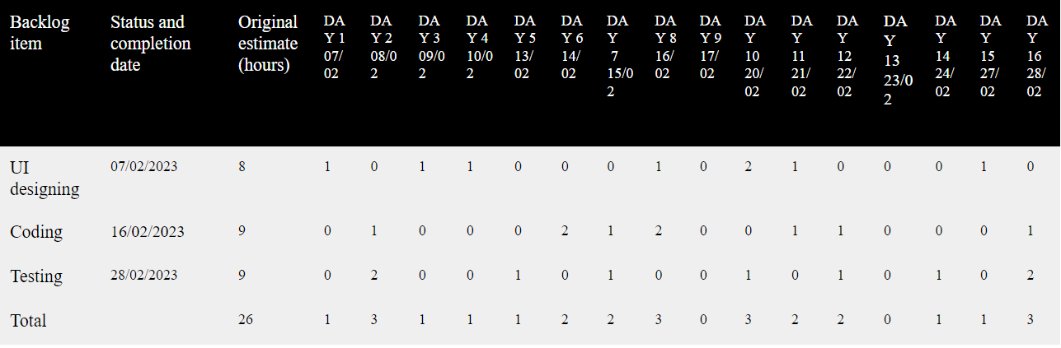
Smart policing technique with crime type and risk score prediction
SPRINT PLAN:1
Department of Computer Applications, MES College Of Engineering

Slide 18
Smart policing technique with crime type and risk score prediction
DATA FLOW DIAGRAM
Department of Computer Applications, MES College Of Engineering

Slide 19
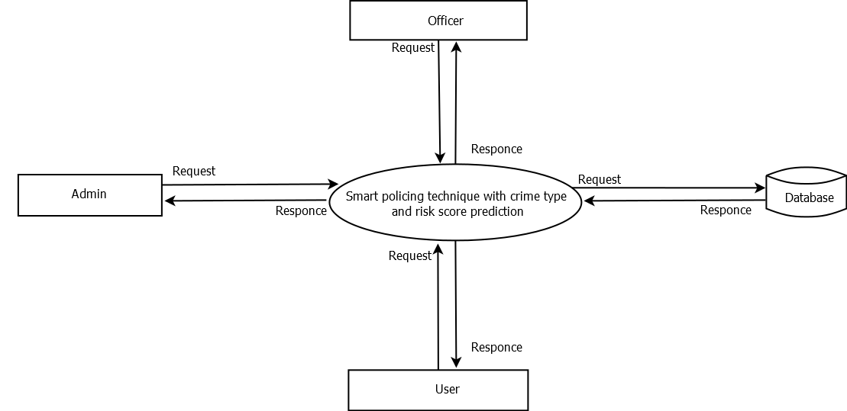
Smart policing technique with crime type and risk score prediction
LEVEL-0
Department of Computer Applications, MES College Of Engineering

Slide 20
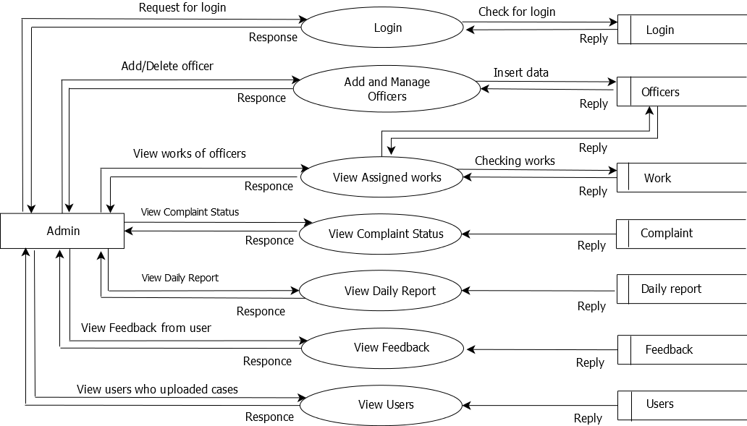
Smart policing technique with crime type and risk score prediction
LEVEL-1
Department of Computer Applications, MES College Of Engineering

Slide 21
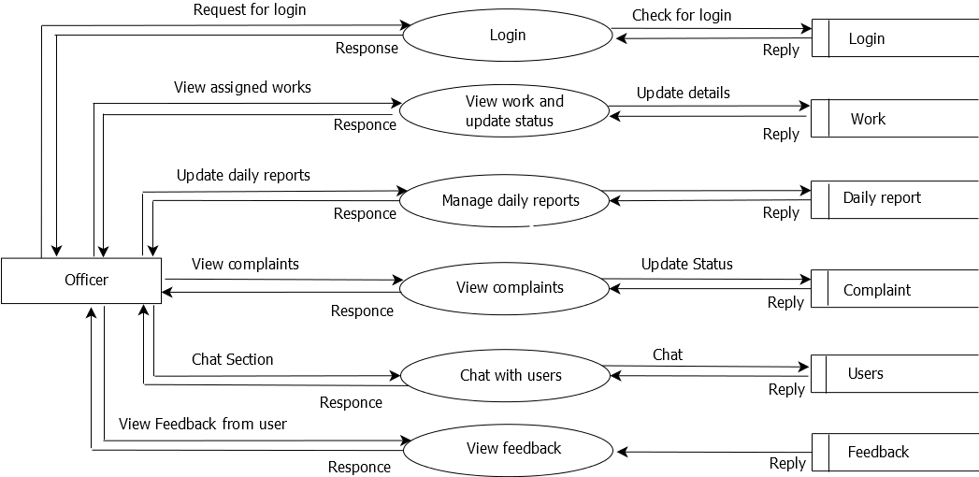
Smart policing technique with crime type and risk score prediction
LEVEL-2
Department of Computer Applications, MES College Of Engineering

Slide 22
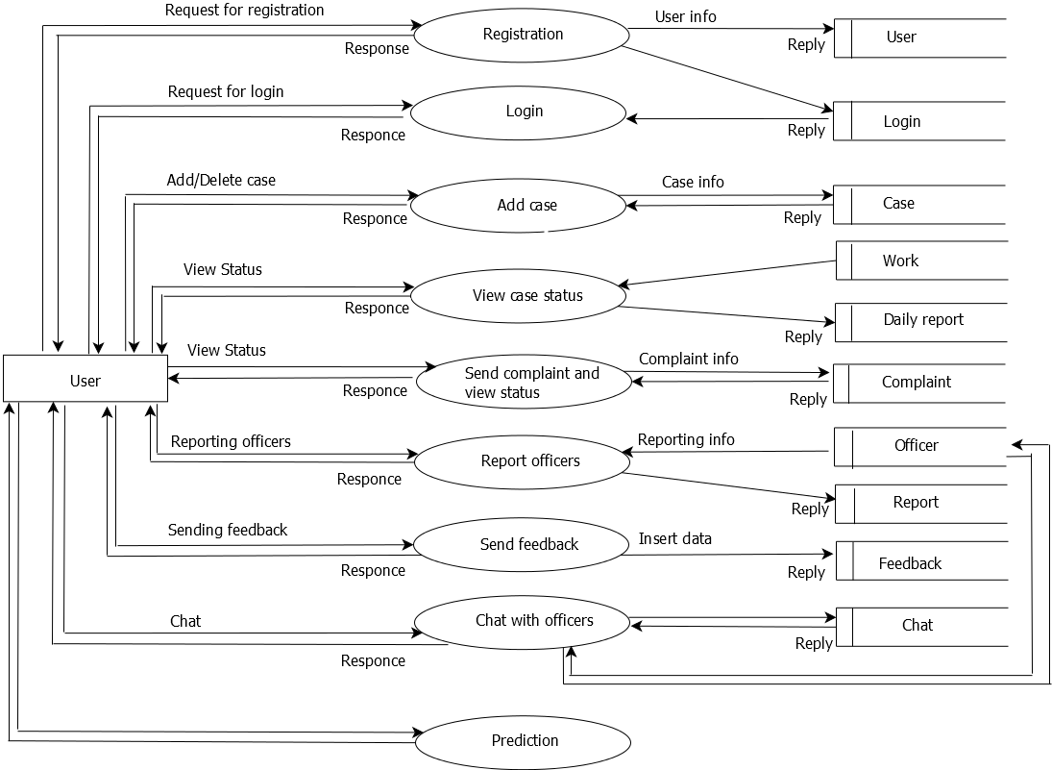
Smart policing technique with crime type and risk score prediction
LEVEL-3
Department of Computer Applications, MES College Of Engineering

Slide 23
Smart policing technique with crime type and risk score prediction
DEVELOPING ENVIRONMENT
Hardware Specification
The selection of hardware is very important in the existence and proper working of any of the software. When selecting hardware, the size and capacity requirements are also important. The hardware must suit all application developments.
Processor : i3 or above.
System Bus : 32 Bit or 64 Bit
RAM : 4GB or Above
HDD : 500 GB or Above
Monitor : 14 LCD or Above
KeyBoard : 108 Keys
Department of Computer Applications, MES College Of Engineering

Slide 24
Smart policing technique with crime type and risk score prediction
Mouse : Any Type of mouse
Mobile : Android supported mobile phone
Software specification
One of the most difficult task is selecting software,once the system requirement is find out then we have to determine whether a particular software package fits for those system requirements.This section summarizes the application requirement.
Operating System : Windows 8 or above
Frontend : Html, Css,Bootstrap
Backend : Python, Java
Database : MySQL
IDE : Android Studio /JetBrains PyCharm
Department of Computer Applications, MES College Of Engineering

